Slide 1
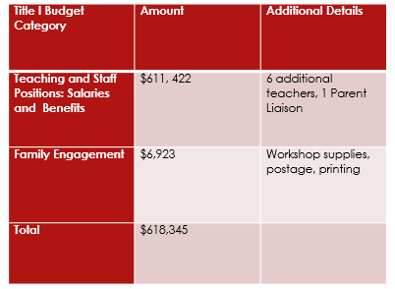
How are Title I Funds Spent at our school? School Year 2024- 2025
Each expenditure must be aligned to our school’s LSPI.

